Slide 1
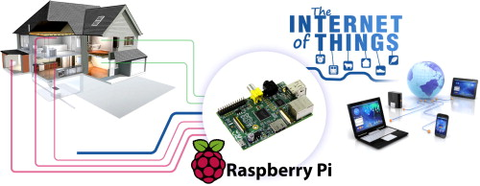
Home Automation Using Raspberry Pi
Presented by:
Manvir Singh (40040143)
Mounika Kiran Eluri (40055028)
Natasha Basutkar (40081017)
Sushma Reddy Gurram (40086757)

Slide 2
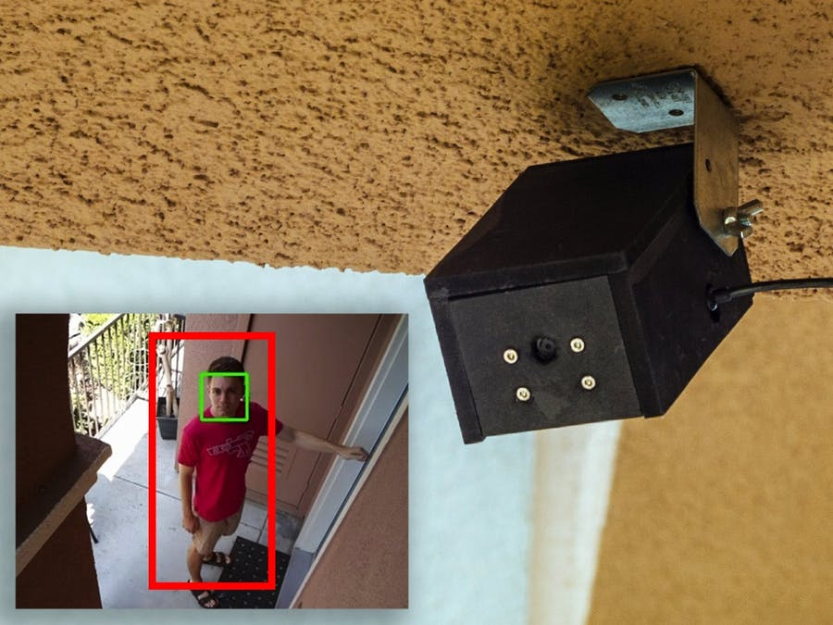
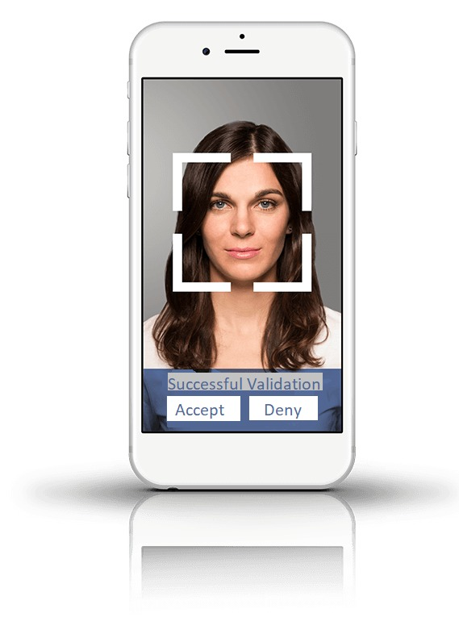
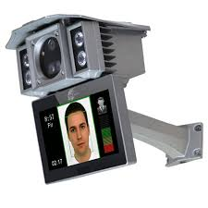
Introduction & Goal
Face recognition based door locking and unlocking system.
Face detection based intrusion detection.
Face detection based package receiving functionality.
Mobile App with push notifications to authorize or enable security functions.

Slide 3
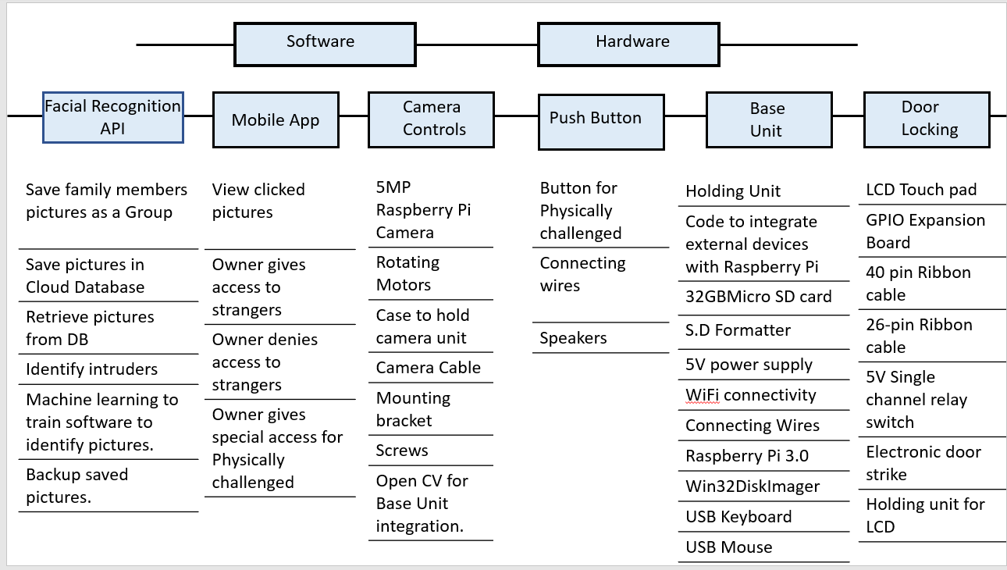
System Block diagram

Slide 4
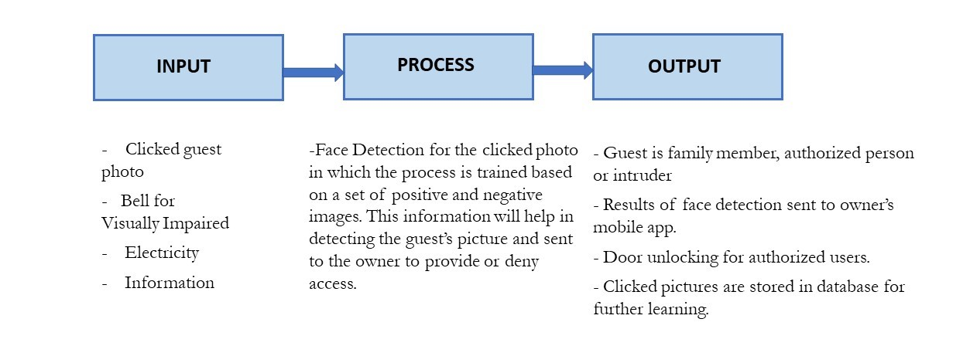
Process

Slide 5
Quality Factors
Performance: Efficiency, Reliability, Survivability, Usability, Integrity
Design: Verifiability, Maintainability, Sustainability
Adaptation: Portability, Interoperability, Flexibility, Expandability, Reusability.

Slide 6
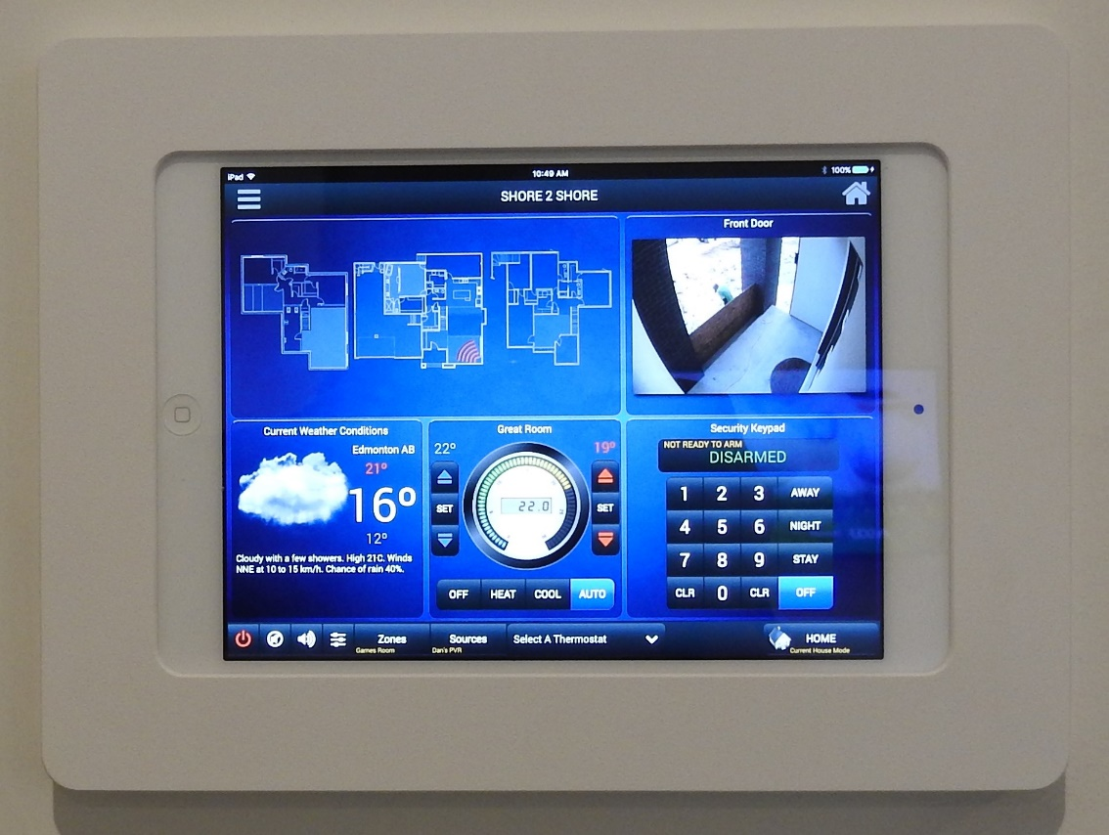

Human Factors
Anthropometric Factors : Camera, Touch Pad, Push button
Interface : User-friendly, ease of operation, Comfortability.
Sensory Factors : Vision and Hearing.
Reaction time : 2 minutes

Slide 7

Sustainability
Reuse
Remanufacturing
Recycling
Wastage

Slide 8
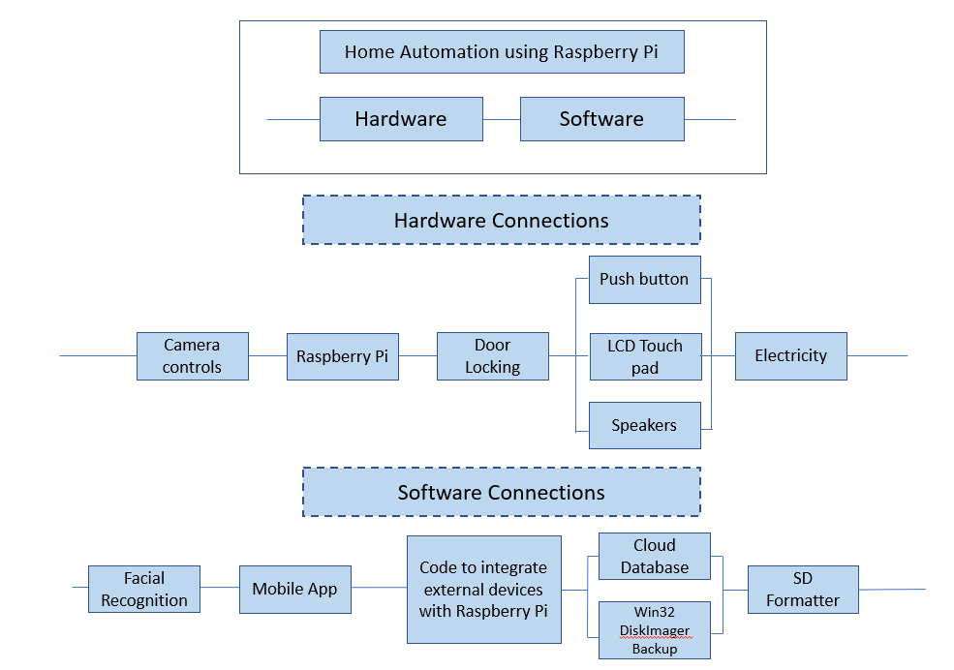
Reliability : First & Second levels of Decomposition

Slide 9
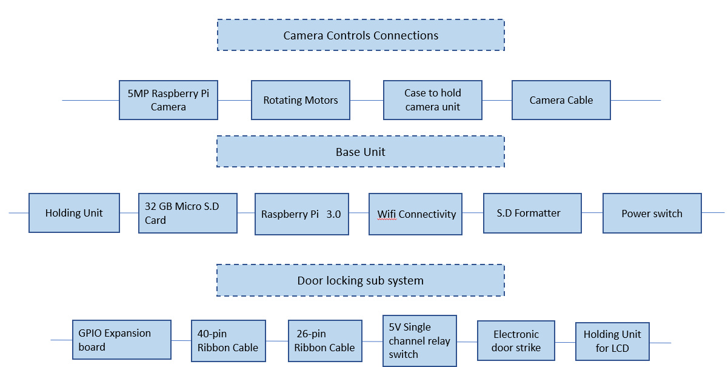
[
Reliability : Third Level of Decomposition

Slide 10
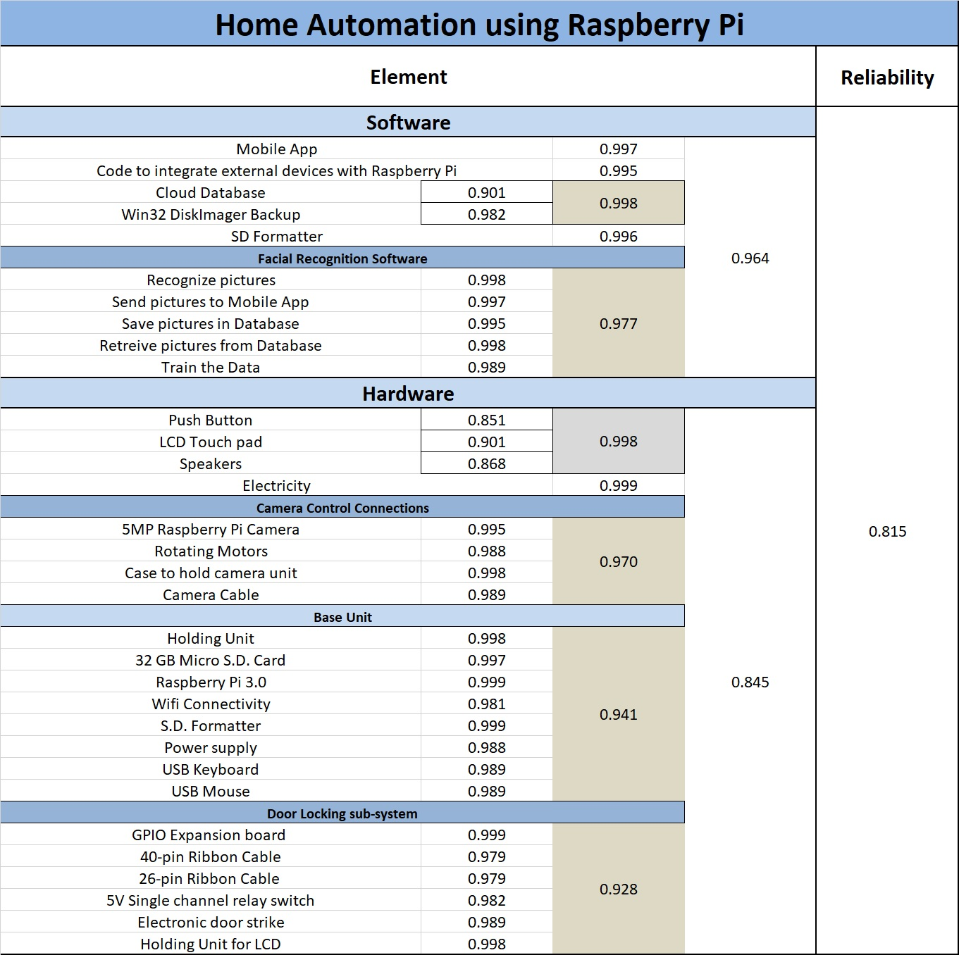
Reliability Calculations

Slide 11
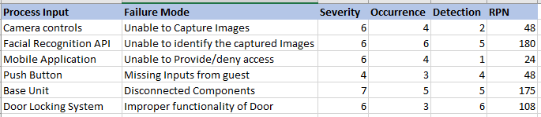
FMEA(Failure Mode & Effect Analysis)

Slide 12
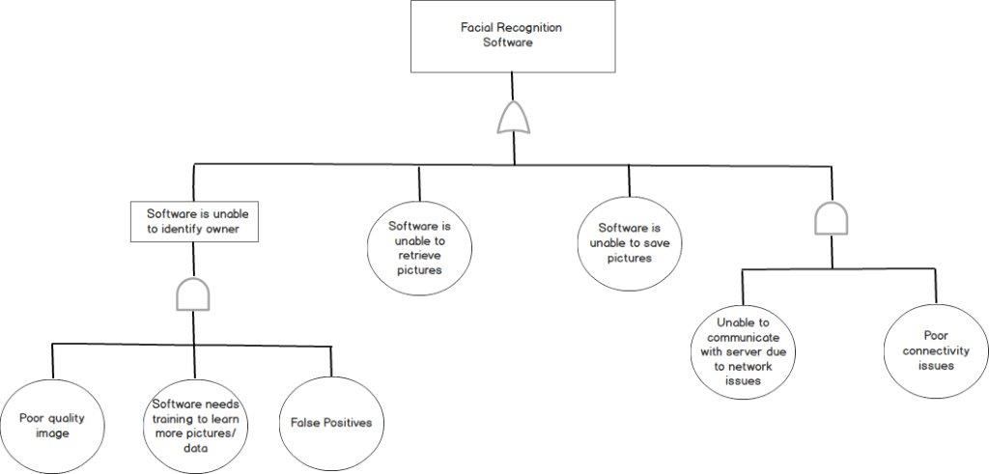
Fault Trees : Facial Recognition API

Slide 13
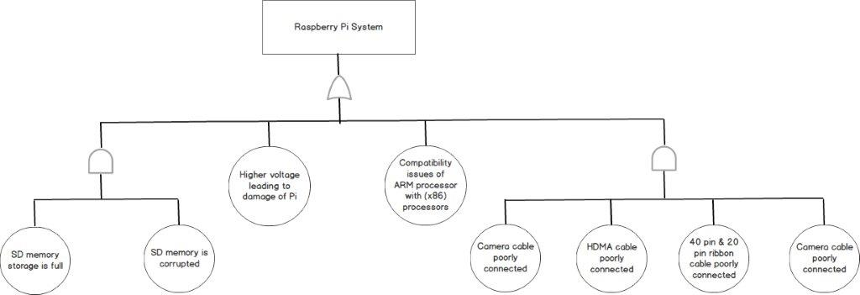
Fault Trees: Raspberry Pi System

Slide 14
Maintainability
Corrective : Scheduled Booting
Preventive & Perfective : Unscheduled Booting, Software Upgrade
Adaptive : HAAR Classifier & Camera.

Slide 15
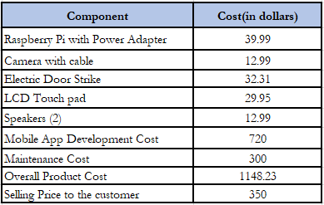
Conclusions & Future Enhancements
System is Reliable & Economical
LCD Touch pad can be replaced with Sensors for Easy of use and better accessibility.
Additional features inclusive of Emergency call and Courier Facility

Slide 16
Questions?

Slide 17
Thank you & Good bye

